Slide 1


Career and Responsibility of A Requirement Engineer
Section : A
Group : 3
Farjan Ahmmed
Md. Moshequl Islam Alif
Farhan Omar Bhuiyan Sadid
Maimun Bin Masud
Mohammad Ali Nayeem

Slide 2
Farjan Ahmmed
ID : 232-35-738

Slide 3

Introduction
A Requirement Engineer defines and organizes project needs for successful development.
3

Slide 4





Importance of Required Engineering
Understanding Stakeholder Needs
Minimizing Risks
Enhanced Communication
Improved Project Planning
Quality Assurance

Slide 5
Role of A Requirement Engineer
Analyze and prioritize requirements
Document and communicate
Elicit and gather requirements
Validate and verify implemented solutions
Manage changes to requirements
5

Slide 6
Md. Moshequl Islam Alif
ID : 232-35-025

Slide 7

Skills for Requirement Engineering
Analytical Skills
Communication Skills
Problem-Solving
Documentation Skills
Technical Proficiency
Interpersonal Skills
Adaptability
Negotiation Skills
Attention to Detail
7

Slide 8




Methods and Techniques
Documentation
Maintenance
Elicitation
Validation
8

Slide 9

Creativity in Requirement Engineering
Definition
Identification of Delighters
Problem Solving and Adaptability
Stakeholder Collaboration
Evaluation Criteria

Slide 10
Farhan Omar Bhuiyan Sadid
ID : 232-35-061

Slide 11

Requirement Engineering in Digital Age
Agility and Flexibility
Cloud Computing and Scalability
User-Centric Focus
Security and Compliance
Continuous Feedback Loops
Cross-functional Collaboration
Data-driven Decision Making
Automation and DevOps
11

Slide 12
Driving Digital Transformation
Understanding Business Objectives
User-Centric Design
Agile Methodologies for Flexibility
Integration of Data and Analytics
Scalability and Future-Proofing
Aligning requirements with digital solutions can effectively contribute to the business strategy.
Capturing and prioritizing user needs, ensuring that digital solutions are intuitive, user-friendly
Organizations to respond quickly to market dynamics and evolving customer requirements.
Defining data requirements and analytics capabilities
Scalability requirements to accommodate future growth
12

Slide 13
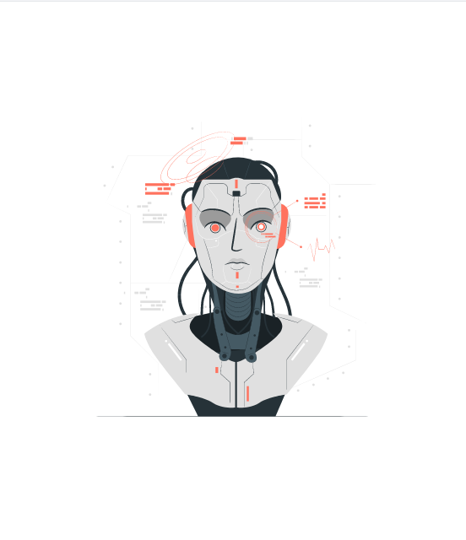





The Future of Requirement Engineering
AI and Automation Integration
Agile and DevOps Evolution
Increased Focus on User Experience (UX)
Data-Driven Decision Making
Blockchain for Traceability and Security
Real-time Collaboration Tools
13

Slide 14
Maimun Bin Masud
ID : 232-35-064

Slide 15
Challenges in Requirement Engineering
Lack of Documentation or Over-documentation
Changing Requirements
Incomplete or Unclear Requirements
Lack of Stakeholder Involvement
Communication Issues

Slide 16





Turning Challenges into Opportunities
Incomplete or Unclear Requirements
Changing Requirements
Communication Issues
Lack of Stakeholder Involvement
Conflicting Requirements
Opportunity for Collaboration
Opportunity for Agile Adaptation
Opportunity for Transparency
Opportunity for Engagement
Opportunity for Negotiation
16

Slide 17




The Triumph of Effective Requirement Engineering
User Satisfaction and Adoption
Alignment with Agile Methodologies
Clear Understanding of Objectives
Reduced Rework and Costs
17

Slide 18
Mohammad Ali Nayeem
ID : 232-35-022

Slide 19
Precision in Requirement Engineering
Clear Goals Matter
Smart Goals Help
Keeping Things Consistent
Simple Language is Best
Choosing What's Most Important
Following the Trail
Being Specific Helps
Counting What Counts
Validation and Verification

Slide 20
Balancing Creativity and Precision
Clear Vision and Objectives
User-Centric Design Thinking
Structured Requirement Elicitation
Prototyping and Mockups
Agile Methodologies
Cross-Functional Collaboration
Risk Management
Innovation Workshops
Iterative Feedback Loops
Use of Visual Models
20

Slide 21




Conductors of Project Success
Interpreting Stakeholder Needs
Conductor Role: Requirement engineers interpret and translate stakeholder needs into clear and actionable requirements
Creating Harmony Among Stakeholders
Conductor Role: Requirement engineers facilitate collaboration and consensus among stakeholders, resolving conflicts and ensuring that diverse perspectives are considered.
Balancing Creativity and Precision
Conductor Role: Requirement engineers strike a balance between fostering creative solutions and maintaining precision.
21

Slide 22




Thank you
Section : A
Group : 3

